Slide 1

ROTTEN TAMATO MOVIE RATING
An overview of various statistics related to Rotten Tomatoes' tomatometer ratings.
Presented By: Ruchi Kumari

Slide 2
Problem & Background
The movie industry relies heavily on audience and critic feedback to determine the success of films. Rotten Tomatoes, a leading movie review aggregator, provides ratings and reviews for over 15,000 movies, encompassing critics' Tomatometer scores and audience ratings. However, there is often a discrepancy between critics’ and audience perspectives, leading to polarizing reviews. Studios and filmmakers require a deeper understanding of these ratings to improve content creation, align marketing strategies, and make data-driven decisions.

Slide 3

Tomatometer Ratings
Tomatometer ratings counts from 1 to 100.
Highest count persentage is 37% under the "R" rating category.

Slide 4
Genre And Rating Distribution
The dataset shows "R" ratings dominate adult-focused content production, particularly in documentary and art house & international genres, while family-friendly genres (G, PG) have a smaller share.

Slide 5

Genre and Rating Distribution
43.47% rating received from certified fresh, and 17.77% ratings received from rotten.

Slide 6

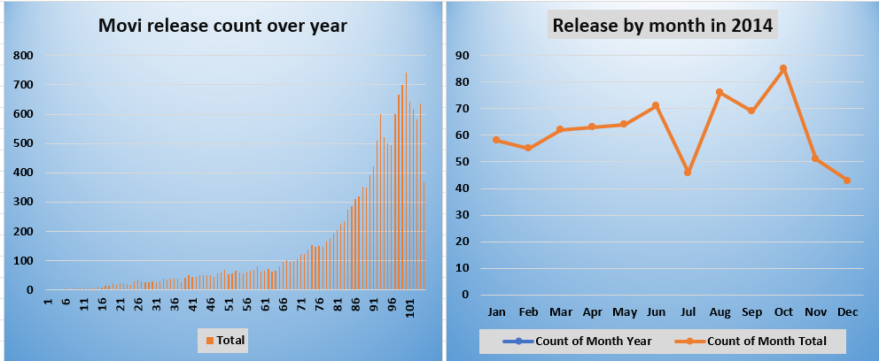
Release Year and Month
Highest movies released in 2014 with a count of 743.
October month has the highest count for new release movies at 85.

Slide 7

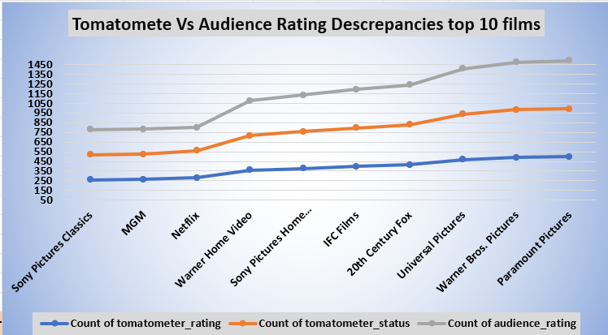
Critic vs. Audience Ratings
Some movies have discrepancies between tomatometer rating and audience ratings. Below are the Top 10 Discrepancies Films
Sony Pictures Home Entertainment has the lowest rating studio with movies count less than 350.
Paramount Pictures is the highest rating studio.

Slide 8

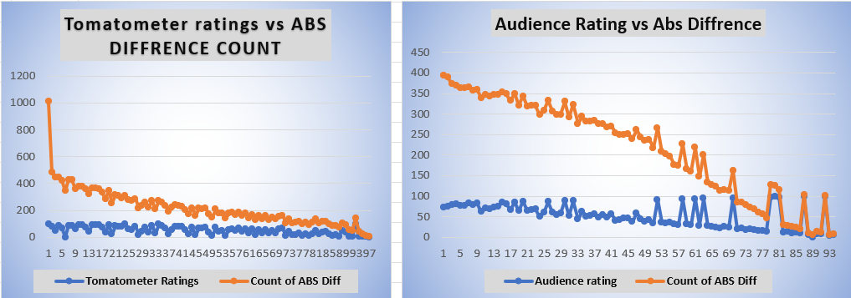
Audience and critics discrepancies
High Discrepancy Films: These are likely polarizing films that divide opinion between audiences and critics. Studios can use this insight to better align content with audience preferences or manage expectations.
Smaller Differences: Films with smaller discrepancies are generally more universally appealing or perceived similarly by both audiences and critics.

Slide 9

Critics Consensus
From 8309 critics consensus comments, 63.25% are positive.

Slide 10
Conclusion:
R-rated films dominate.
Comedy and Drama are the most common genres.
Positive critical sentiments prevail (63.25%).
October and 2014 were peak periods for film releases.
Studios like Sony Pictures Classics excel in quality over quantity.

Slide 11

Recommendations:
Suggest strategies for stakeholders:
1. Studios should target R-rated and PG-13 audiences while balancing quality. 2. Release films in October for better traction. 3. Address discrepancies between audience and critics' preferences.

Slide 12

1. Studios should target R-rated and PG-13 audiences while balancing quality. 2. Release films in October for better traction. 3. Address discrepancies between audience and critics' preferences.
Recommendations:
Suggest strategies for stakeholders:

Slide 13


